Slide 1

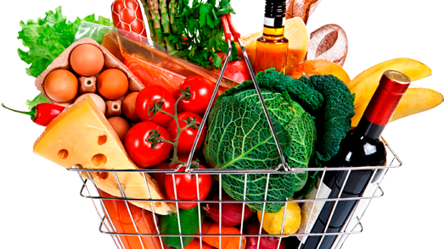


The 4 Wise Miners
Team – 21
Pritish Chandhok (19230221)
Rajath M.R. (19230190)
Saket Kumar (19230134)
Anurag Gautam (19230446)

Slide 2

Basket Analysis
It will cover segmentation based on Product Categories, Basket Values and Units.
Customer Analysis
It will cover segmentation based on the customers spending and Basket Information.
Conclusion
The Conclusion will provide recommendations for the future in order to gain maximum sales and benefits from the Business.
Recommendations on how the store should be categorized and how segmentation should be done.
Business
Value
Agenda

Slide 3
Basket Statistics
(March 2013 – May 2013)
Basket Value Statistics
Total Basket Value | 519913.9
Average Basket Value | 11.47004
Minimum Basket Value | 0.02001
Maximum Basket Value | 162.16426
Basket Unit Statistics
Total Basket Unit | 201875
Average Basket Unit | 4
Minimum Basket Unit | 1
Maximum Basket Unit | 22

Slide 4
Value Based Analysis of the Various Categories
Category | Value | Percentage of Total Value
Groceries, Drinks and Laundries | 258,486 | 49.72%
Fresh, Canned Food and Bakery | 133321 | 25.64%
Frozen and Cold Storage products | 104521 | 20.10%
Household, Home and Entertainment | 14513 | 2.79%
Clothing and Home Furnishing | 4358 | 0.84%
Mobile Networks | 3610 | 0.69%
Electronics | 1105 | 0.21%

Slide 5
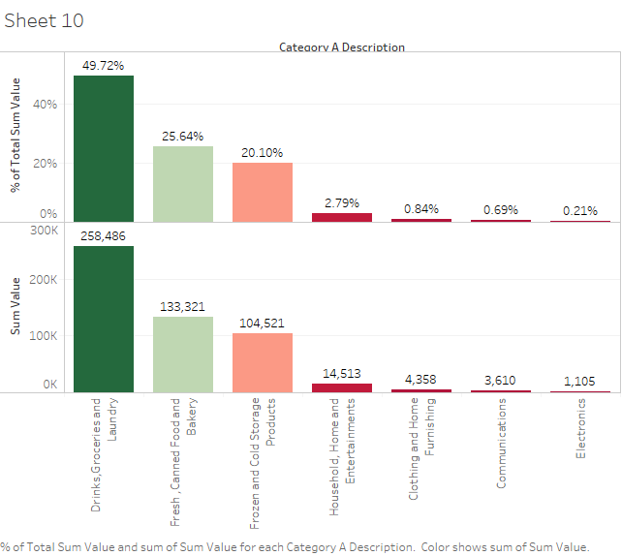

Slide 6
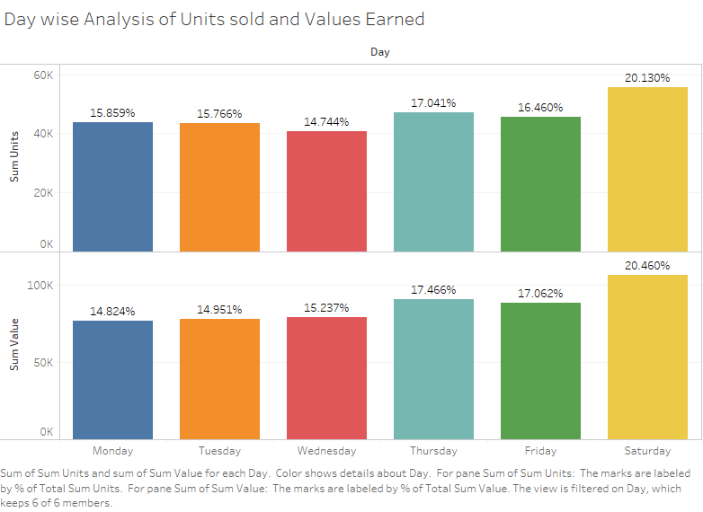
Weekly Analysis of the Basket Values and Sum Units

Slide 7

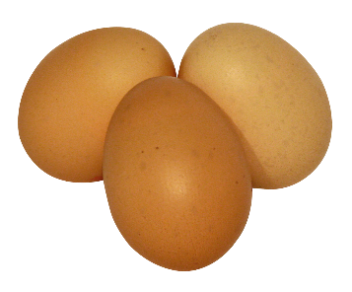
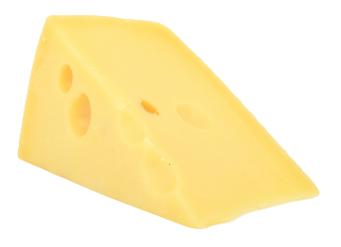
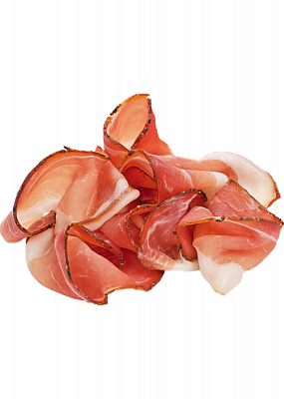
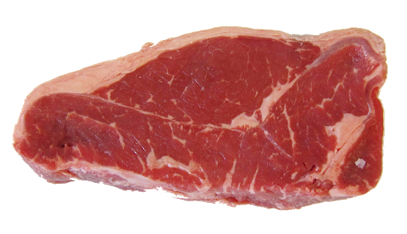
Diapers and Beer - Basket Associations
70 %
Limited edition Special Bread
Poultry
Counter soft cheese
66 %
Limited edition Special Bread
Counter soft cheese
prosciutto
64 %
beef
Counter soft cheese

Slide 8
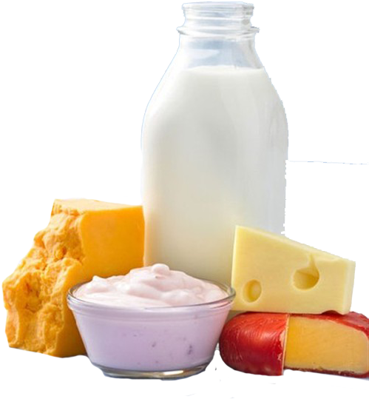
Some more Basket Associations
Items | Associated Item
Packed soft cheese | Chorizo
Cucumbers | Tomatoes
Counter Soft cheese , High pasteurized Milk | Limited duration special packed bread
sliced packed cheese | Limited duration special packed bread

Slide 9
Customer Statistics
(March 2013 – May 2013)
Age Based Statistics
Total Customer | 217607
Average Customer Age | 50 years
Minimum Customer Age | 15 years
Maximum Customer Age | 90 years
Gender Based Statistics
Total Customer | 217607
Total Male Customer | 67066 (30%)
Total Female Customer | 150541 (70%)
Age (15 - 40) Years | 72798 (33%)
Age (41 - 60) Years | 91017 (42%)
Age (61 - 90) Years | 53792 (25%)

Slide 10
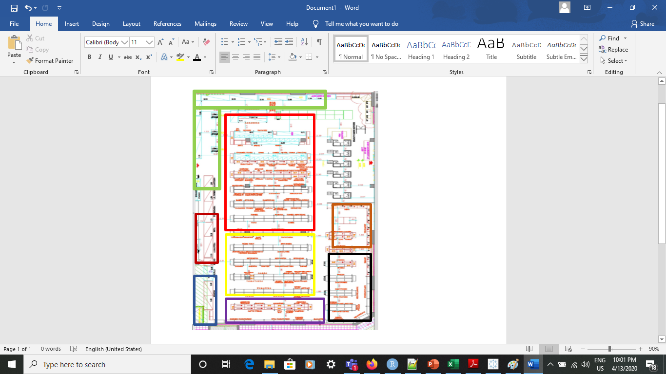
Creating Business Value
Frozen and Cold Storage Products
Groceries and Laundries
Fresh, Canned food and Bakery
Household, Home and Entertainment
Clothing and Home Furnishing
Mobile Networks
Electronics
Drinks

Slide 11
Key Performance Indicator
Basket Volume – Increase the Basket Volume by 10% in next 1 months.
Basket Value – Increase the Basket Value by 20 % in next 6 months.
Basket Variety – Increase the Basket Variety by 10% in next 3 months.
Peak Days – Increase the sales value by 10 % during days and hours in next 6 months.
Revenue – Increase the Overall revenue of the store by 10 % in next 1 year.

Slide 12
Conclusion
Rearrangement of the shop based on the Value generated by Categories.
Maintain a good Supply chain for products that are in demand like coffee, cheese, milk etc.
Increase the area of categories like Grocery in the store and place them at the entry, as they bring maximum value.
Categories like mobile networks and electronics which bring less value should not be placed at the entry rather place them away from Groceries to avoid crowd.
Provide Offers and Reward points to the consumers with Valid Card ID based on the amount of shopping they do.
To increase the Basket Value, arrange the associated products like Bread, cheese, poultry, meat etc. together provide discounts and offers on them.

Slide 13
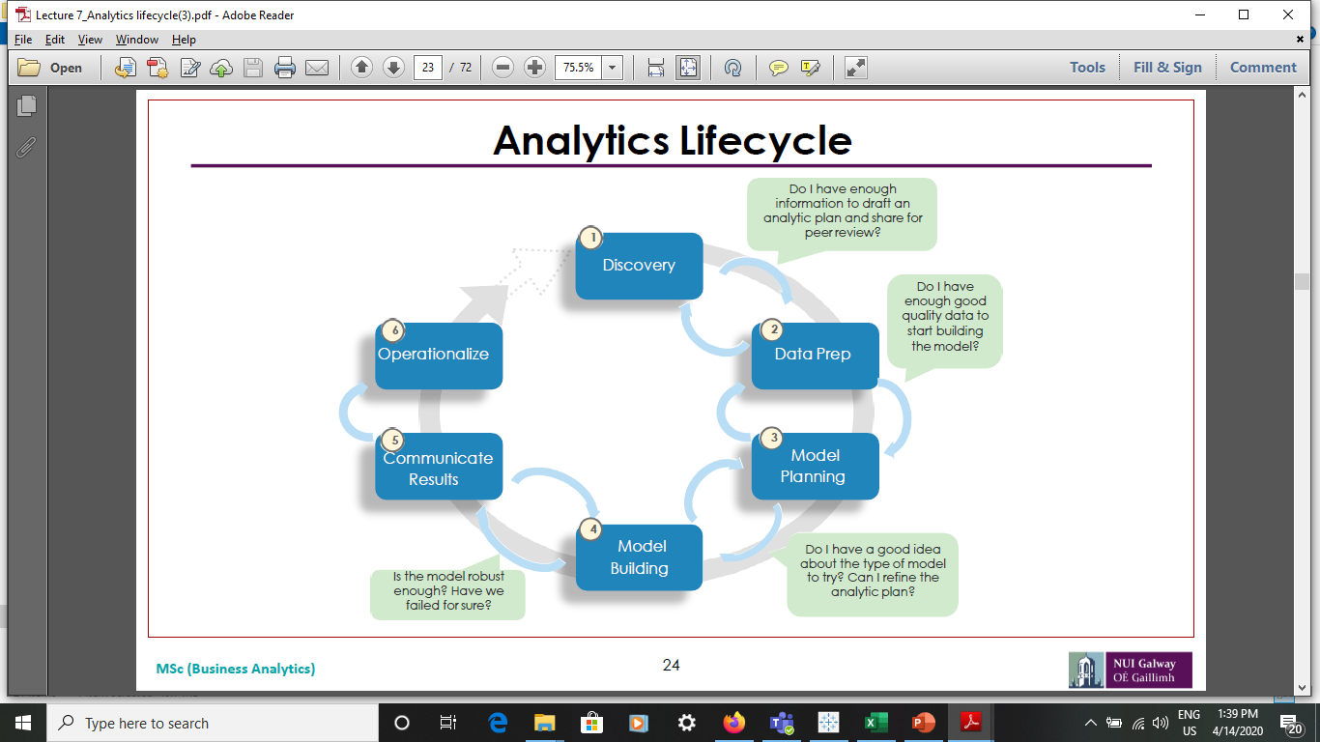
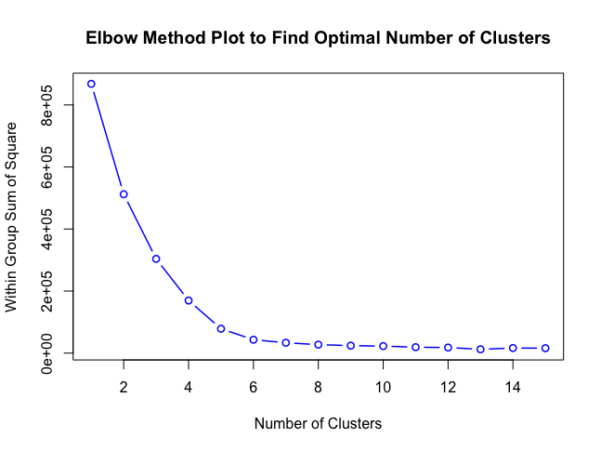
Appendix
Approach Followed for Analysis
The Analytics life cycle was followed where we understood the data, prepared the data using R, excel and python , ran the K- means clustering and association rule using R and python for analysis. The results were communicated using Tableau data visualization and Operations were explained in the conclusion.
Algorithm Followed for Clustering
The K means algorithm was used to find the number of clusters for our analysis in R. It is a method of vector quantization, originally from signal processing, that aims to partition n observations into k clusters in which each observation belongs to the cluster with the nearest mean, serving as a prototype of the cluster.

Slide 14





Tools Used
Data Preparation and Statistics
The data was cleaned using Excel, R and Python to remove all the unnecessary values to enhance the quality. The SPSS was used to derive the descriptive statistics related to the dataset, Excel and R was also used to merge the data using VLOOKUP Function in Excel.
Data Visualization
The data was fed to Tableau to create interactive dashboards in order to understand the customer segmentation and Basket segmentation. Clustering was also carried out using Tableau.

Slide 15
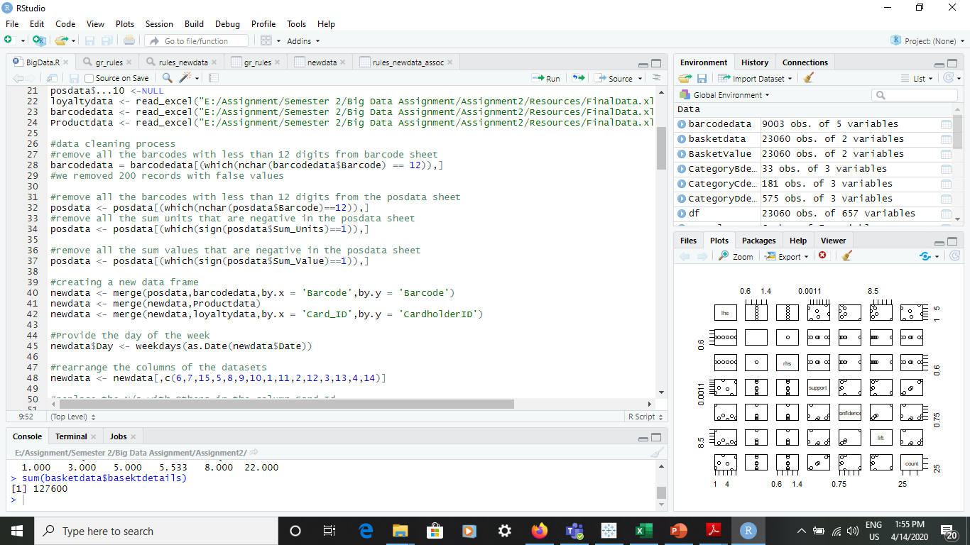
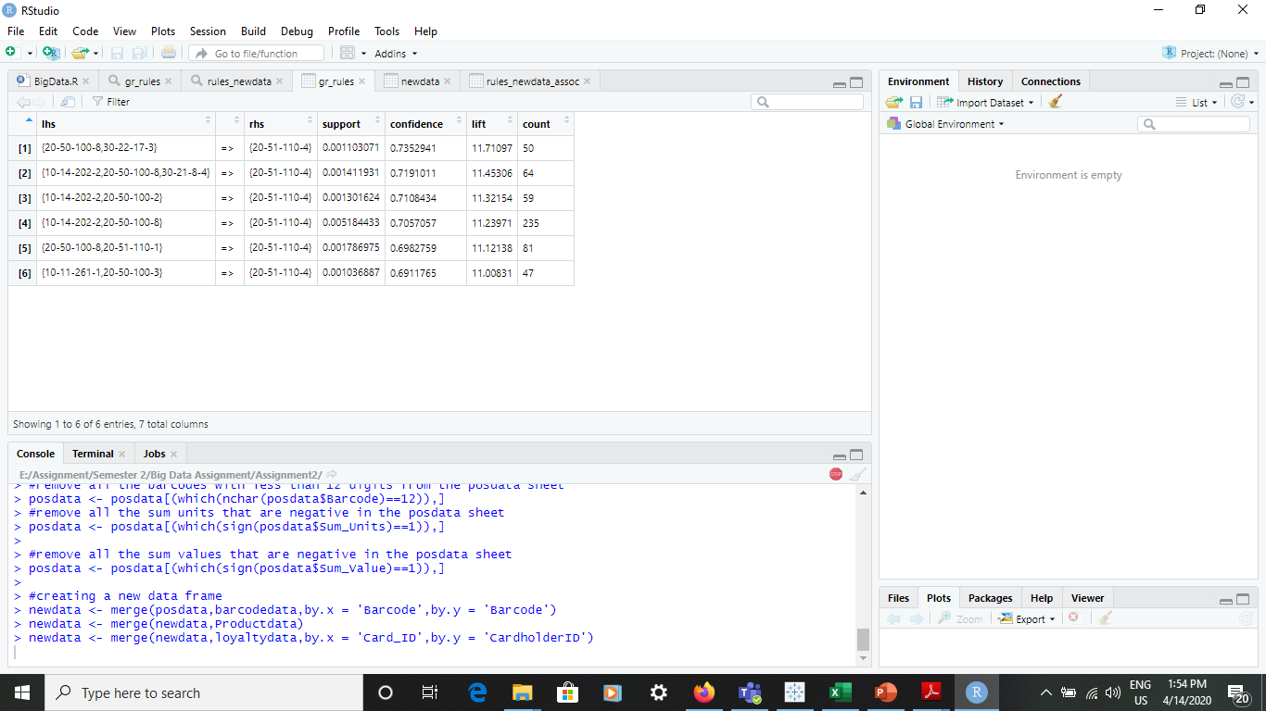
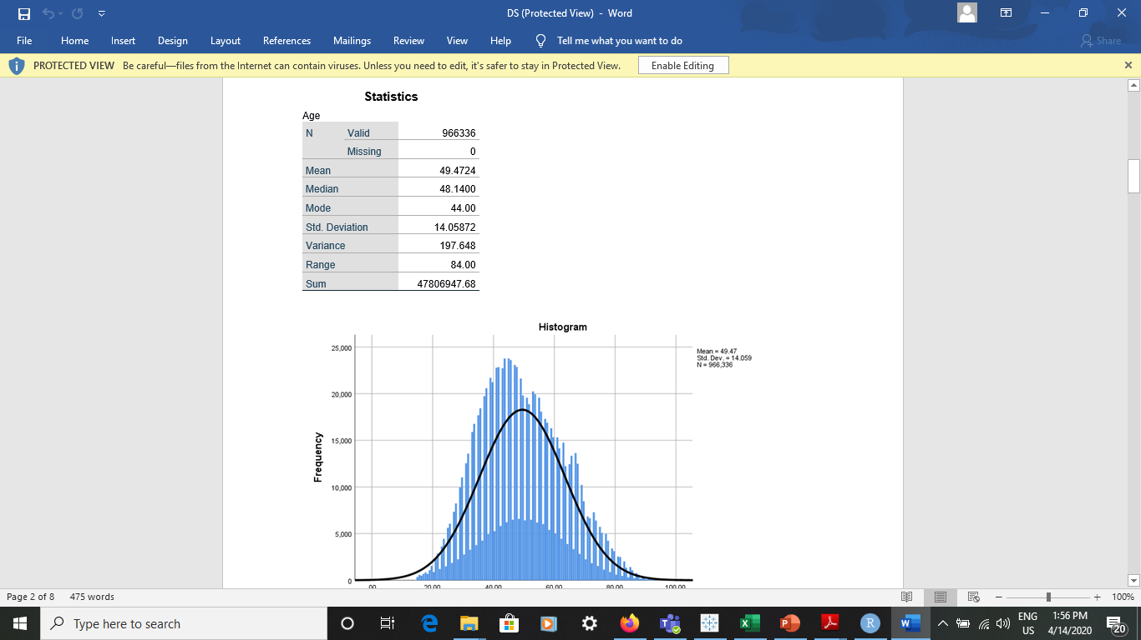
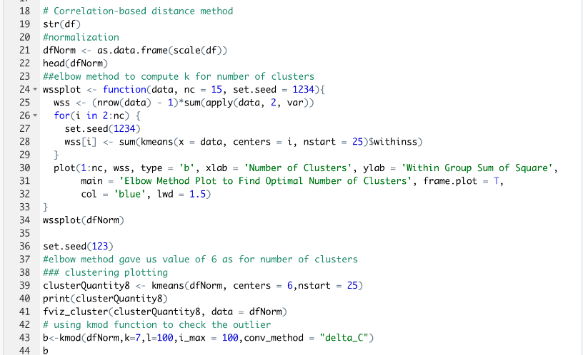
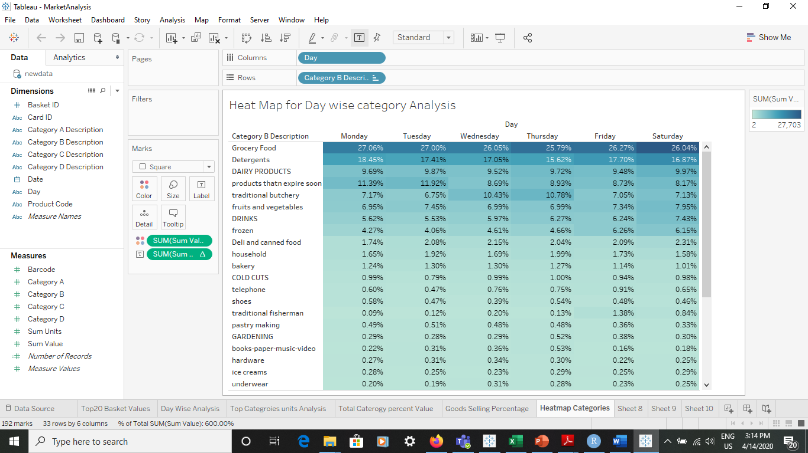
Techniques and Algorithms Used
Association Rule was used to understand the association between the products and categories and to understand the customer’s behavior in buying the products. This was done using the arules package in R.
Following Confidence score was assigned to understand the association between products and categories.
Cluster analysis was done using the K means algorithm to understand the behavior by forming clusters.
Descriptive statistics helped us to understand the Average, Minimum, Maximum, Variance and Total Numbers.

Slide 16



Slide 17

References
Griva et al. - 2018 - Retail business analytics Customer visit segmentation using market basket data-annotated.
Miguéis, Camanho, Falcão e Cunha - 2012 - Customer data mining for lifestyle segmentation-annotated.
Cil - 2012 - Consumption universes based supermarket layout through association rule mining and multidimensional scaling-annotated.

